Slide 1


MEMORY EFFICIENT ONLINE HIERARCHICAL CLUSTERING BASED ON OVERSAMPLING
Samed ARSLAN

Slide 2
Contents
Introduction
Related Works
  Hierarchical Clustering on Very Large Datasets
  SMOTE
Materials and Methods
  Dataset
  Validation
Propose Method
Statistical Test
Experiments
Conclusion and Discussion

Slide 3
Introduction
A hierarchical method with efficient on low memory conditions
Iterative approach with information transfer
Train data as mini batches
Real-time prediction

Slide 4
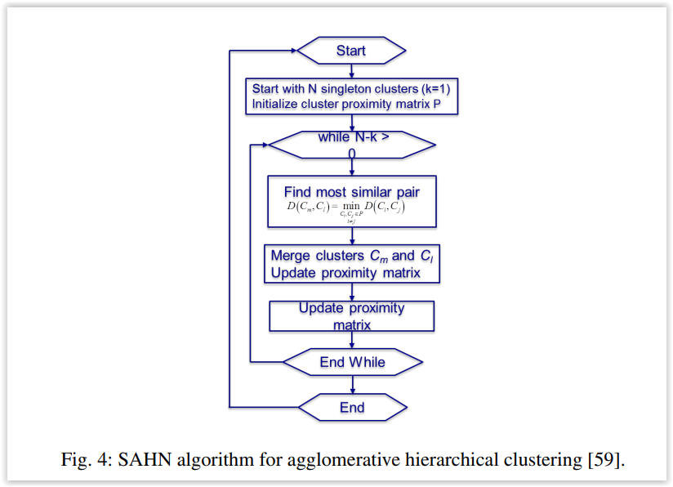
Related Works
An Efficient Hierarchical Clustering Algorithm for Large Datasets
(Genomics Institute of the Novartis Research Foundation)
  Pre clustering with kmeans
  Utilizes a triangle inequality to avoid unnecessary distance computations
  HC for each cluster.
  HC is preformed to cluster k centroids and combine the trees into a complete tree.
Sequential Agglomerative Hierarchical
Non-overlapping clustering (SAHN)

Slide 5
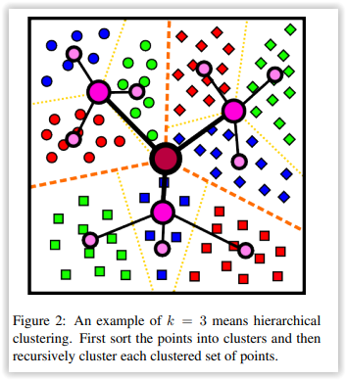
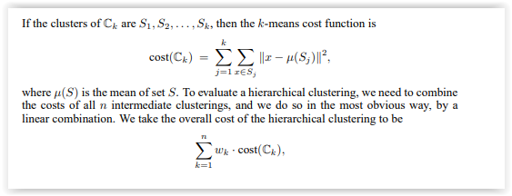
Related Works
Hierarchical k-Means for Unsupervised Learning
  Centroid based divide and conquer approach
  Clustering to divided dataset, after cluster centroids.
An iterative improvement procedure for hierarchical clustering
  Using a modified version of the K-Means cost
  A binary tree with the data points at the leaves; and an ordering of the internal nodes
  After leaf updates some local moves needed to update model again

Slide 6
Related Works
SMOTE
    Most using area is inbalanced classification
    Additional %10 accuracy on classification task
    Provides information synchronization with balanced and shrink set

Slide 7
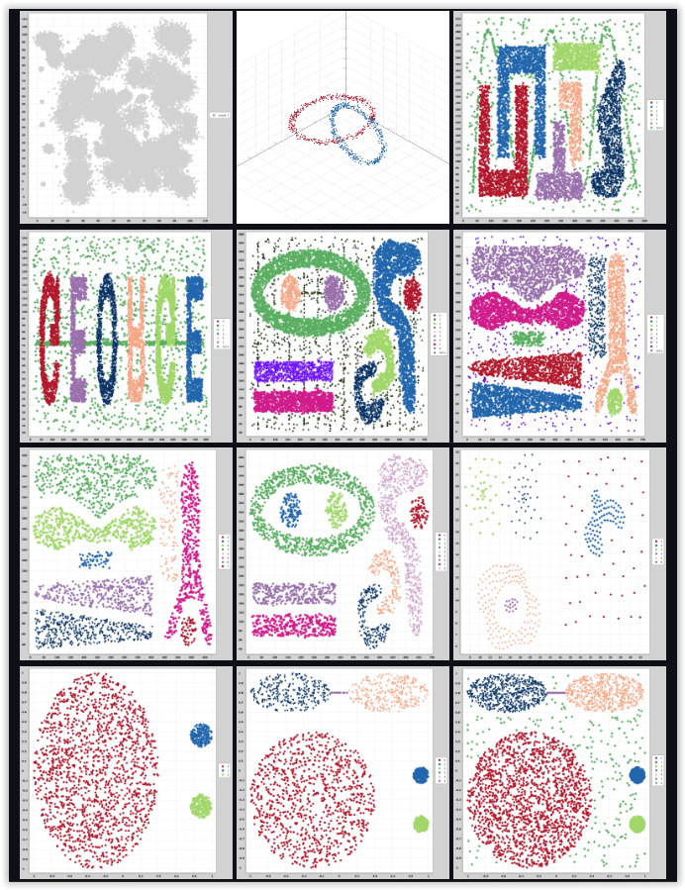
Materials and Methods
Dataset
  Synthetic 108 dataset with different patterns
  https://github.com/SamedArslan90/clustering-benchmark

Slide 8
Materials and Methods
Validation
  Accuracy
  Kappa
  Silhouette
  Dunn Index
  Purity
  Normalized Mutual Information(NMI)
  Variation of Information (VoI)
Cluster Matching
Linear sum assignment problem using the Hungarian method

Slide 9
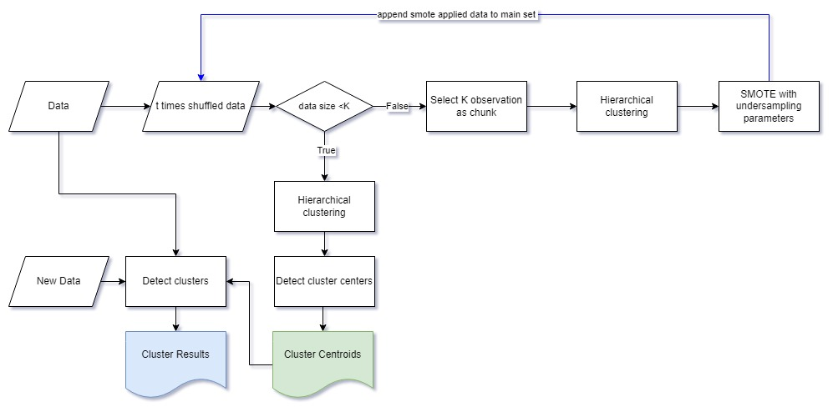
Propose Method

Slide 10
Propose Method
The proposed structure is generally as follows.
The master data is divided into chunks.
Each chunk shuffels
Goes to clustering HC
Each cluster obtained goes for SMOTE, shrinks and get balanced
SMOTE applicated data added to the main data until last clustering
Cluster centers are determined after all chunks are completed.
The master data is assigned according to the cluster centers obtained.

Slide 11
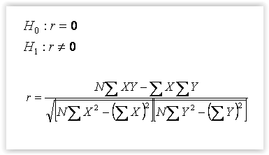
Statistical Test
Pearson correlation
After performance computation for understanding realtionship of features between performances

Slide 12
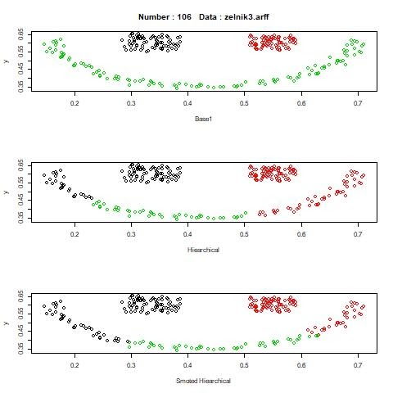
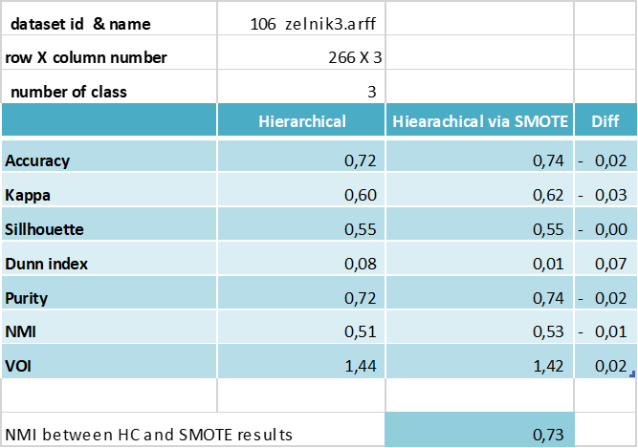
Experiments
Full Result Set

Slide 13
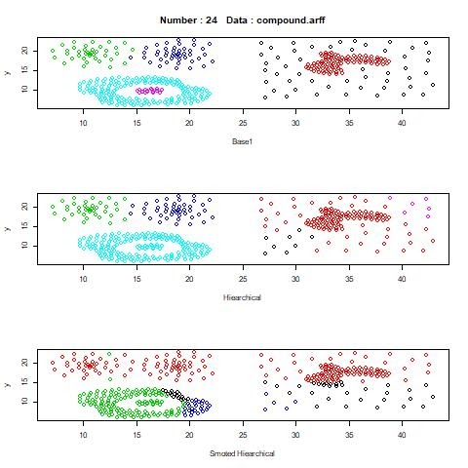
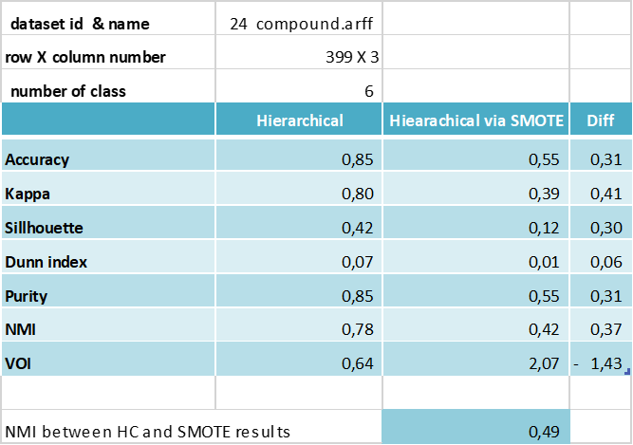
Experiments
Full Result Set

Slide 14
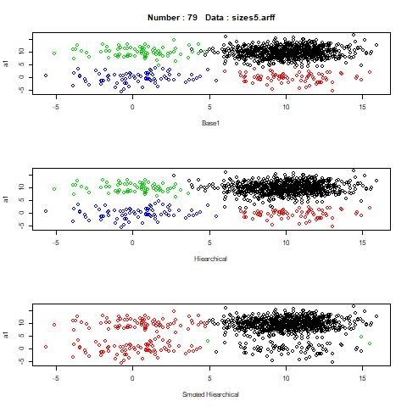

Experiments
Full Result Set

Slide 15
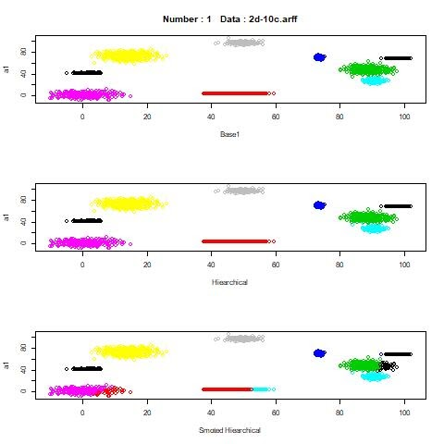

Experiments
Full Result Set

Slide 16
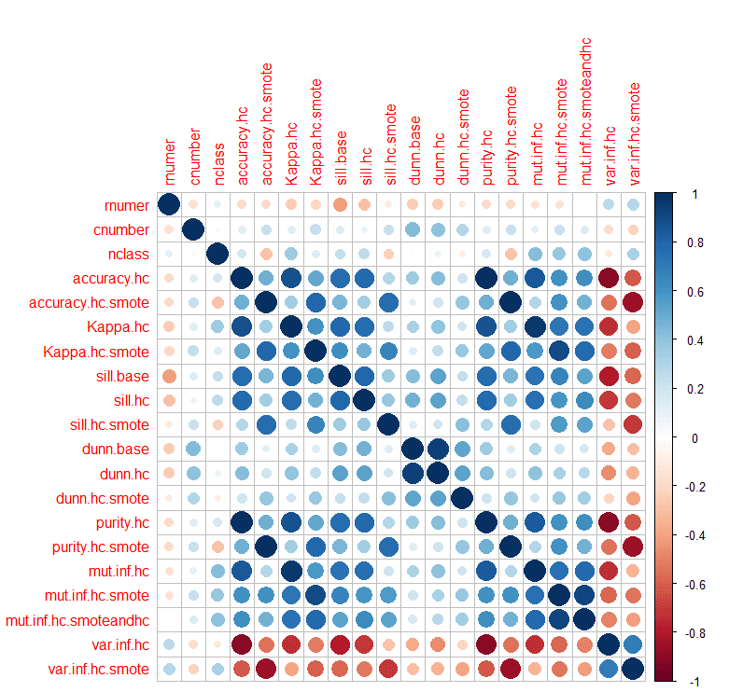
Experiments
Weak inverse correlation between the number of classes and the accuracy of the proposed method
Positive correlation between the calculated silhouette values of the base cluster values and the accuracy values of other clustering methods => If the distance between the clusters increases, it becomes easier to detect the clusters.

Slide 17
Conclusion and Discussion
Average of twelve percent information loss compared to basic HC
Low number of observation and noisy dataset situations are problem for purpose method and regular one
Although the performances for both methods seem similar, sometimes the outputs may not be the same. This makes the proposed method more fragile.
If the data set to be studied with hierarchical clustering is too large to work with the available resources, the proposed method can be used, considering some information loss.
The tradeoff should be well appreciated.
In future studies, the disadvantageous situations mentioned here can be better scrutinized. Algorithms with distance matrix dependency can also be evaluated in accordance with this algorithm flow.

Slide 18
Thanks
1703012 Samed ARSLAN

